Slide 1

Lab 0: FPGA BASIC methodology
James E. Stine, Jr.
Edward Joullian Endowed Chair in Engineering
Oklahoma State University
Electrical and Computer Engineering Department
Stillwater, OK 74078 USA
james.stine@okstate.edu

Slide 2
Objective
The first lab has three main objectives:
The first objective is to learn how to design a basic digital design and verify it using a testbench.
The next objective is to implement it on your DSDB board and compare it to what you get from simulation.
The last objective is to understand the lab structure and report.
History has indicated many people will wait – you cannot complete any lab overnight, be forewarned.
We will revisit lab report later today.
Also, you probably cannot finish this lab in one lab session.

Slide 3
Things to keep in mind
Start early and work with your partner to get things done quickly.
Communication is key to a good relationship.
Do not ask what I can do, just jump in and contribute even if you duplicate work.
Labs are due one week after the lab is complete.
For lab 0, this Friday February 4
Try to schedule the last week of lab for writing up your work, so you basically only have 2 weeks to complete this lab.
Back up often and work upwards (inverted pyramid).
Ask questions on slack or in person early!
Know we are here to help – post screenshots/questions on slack or stop by.

Slide 4
Basics
For this laboratory, we will be using the ELVIS III board.
We have made most of it very simple if you follow the procedure and understand what is going on.
I have uploaded a version of the files that include a directory with the items you need to copy over to your working area once your simulation works.
There is also simulation that I will demonstrate how to make sure this is working before you go to the ELVIS board.
Make sure you have a DSDB board at your desk before you begin.
Ask your TA to install it, if its not there.

Slide 5
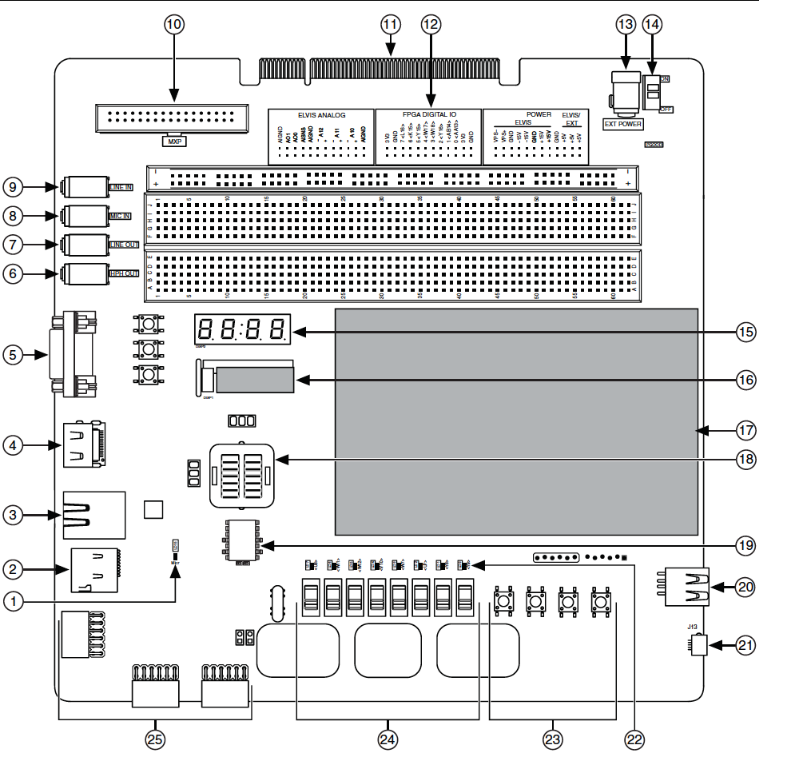
DSDB
18: Zynq XC7Z020-1CLG484C with included Heat Sink
All of the FPGA pins are accessible via the DSDB board either through the schematic or attaching to the debugger

Slide 6
Field-Programmable Gate Arrays
Logic blocks
To implement combinational and sequential logic
Interconnect
Wires to connect inputs and outputs to logic blocks
I/O blocks
Special logic blocks at periphery of device for external connections
Key questions:
How to make logic blocks programmable?
How to connect the wires?
After the chip has been fabbed or fabricated!

Slide 7
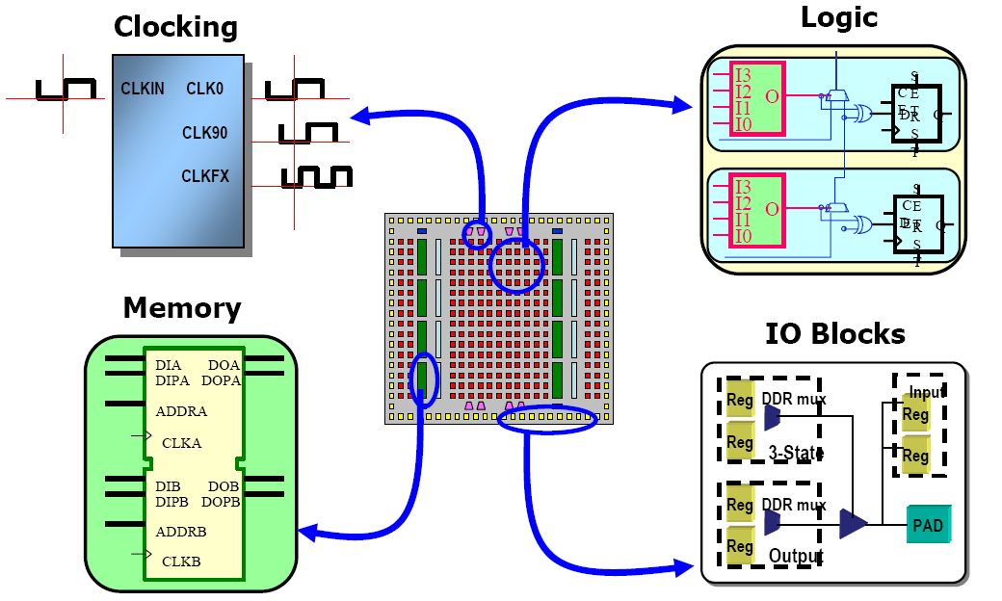
Evolution of FPGA architectures

Slide 8
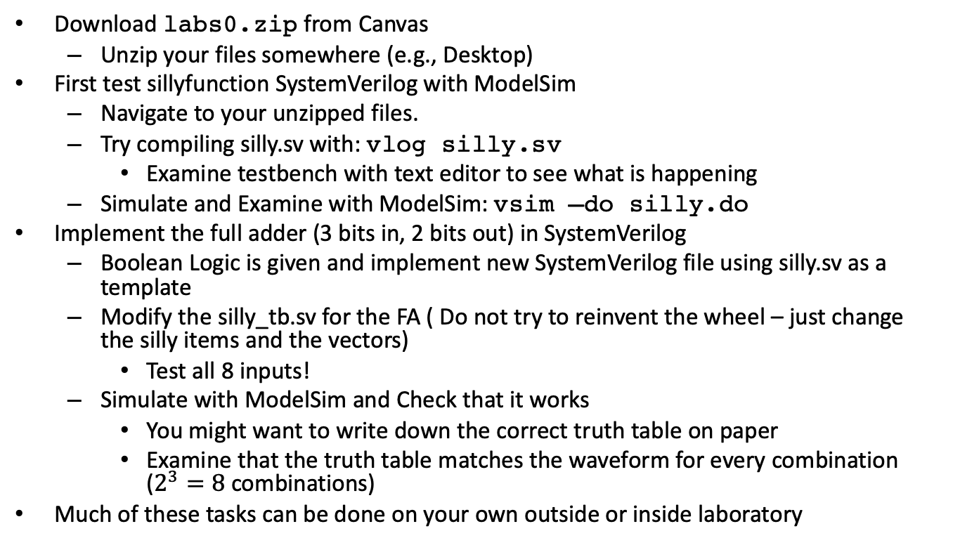
Tasks
Download labs0.zip from Canvas
Unzip your files somewhere (e.g., Desktop)
First test sillyfunction SystemVerilog with ModelSim
Navigate to your unzipped files.
Try compiling silly.sv with: vlog silly.sv
Examine testbench with text editor to see what is happening
Simulate and Examine with ModelSim: vsim –do silly.do
Implement the full adder (3 bits in, 2 bits out) in SystemVerilog
Boolean Logic is given and implement new SystemVerilog file using silly.sv as a template
Modify the silly_tb.sv for the FA ( Do not try to reinvent the wheel – just change the silly items and the vectors)
Test all 8 inputs!
Simulate with ModelSim and Check that it works
You might want to write down the correct truth table on paper
Examine that the truth table matches the waveform for every combination ($2^{3}=8$ combinations)
Much of these tasks can be done on your own outside or inside laboratory

Slide 9
HDL to Gates
Simulation
Inputs applied to circuit
Outputs checked for correctness
Millions of dollars saved by debugging in simulation instead of hardware
Synthesis
Transforms HDL code into a netlist describing the hardware (i.e., a list of gates and the wires connecting them)
Verification
Verifying the forward translation of synthesis is indeed what you started with

Slide 10
Demo of Simulation
Let’s try to simulate silly.do

Slide 11
MGC ModelSim vsim window

Slide 12
Full Adder
The full adder is sometimes called the basic building block of any computation.
Specifically, the full adder is sometimes called a (3,2) counter because it counts the numbers of inputs that are 1.
Use the basic silly module discussed in Lecture 3 for building the full adder.
Make sure you test it thoroughly for all 8 combinations in your simulation with a testbench before you go to your DSDB board.

Slide 13
Instantiating designs
module and3(input logic a, b, c,
output logic y);
assign y = a & b & c;
endmodule
module inv(input logic a,
output logic y);
assign y = ~a;
endmodule
module nand3(input logic a, b, c
output logic y);
logic n1; // internal signal
and3 andgate(a, b, c, n1); // instance of and3
inv inverter(n1, y); // instance of inv
endmodule
When creating HDL, you instantiate other designs in your higher-level HDL.
This allows you to build bigger and better designs.
It uses hierarchy to make more complex designs.
andgate is our instantiated name

Slide 14
Debugging?
You will be implementing your design on your FPGA on the National Instruments DSDB board.
The implementation will be inside the silicon which you cannot see.
So, how do you figure out if something is working? How do you tell something does not work the way you expected it to?
Use debugging techniques!
This includes switches, LEDs, push buttons to help you examine what is happening with the board.
Try to use as many LEDs as you can to see what is on and what is off.
Use your brain to figure out possible problems.

Slide 15
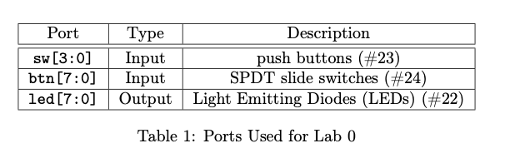
Implementation on DSDB
Once you simulate your design, you should hook up to the DSDB.
Inside your lab0.zip there should be a Demo program.
Unzip and open with Vivado
Modify the top_demo.sv to instantiate your “working” SV and hook up inputs and outputs to things you can see on the DSDB:
Hook your input/output of your instantiated design to debugging items (e.g., LEDs).
Test all 8 possible combinations of your full adder to make sure its working as expected.
Using Vivado (which is Xilinx’s synthesis and place/route tool) - this should be on your desktop in ENDV 360 to run
Run Synthesis
Run Implementation
Generate Bitstream
Per the lab0.pdf, download to the board using the Hardware Manager

Slide 16
Check on DSDB board
DO NOT TRY AN IMPLEMENTATION ON YOUR DSDB BOARD UNTIL IT WORKS IN SIMULATION!
It takes several minutes to go through the three steps inside Vivado (e.g., synthesis).
You want to hopefully do the implementation once or twice.
Use your debugging items and your brain to make sure things are working.
Check on DSDB board whether things work (check against the truth table).
Use the Light-Emitting Diodes (LEDs) to make sure all 8 possible cases match your simulation from ModelSim and theory.
If you like, save any output from the Vivado screen for your report
e.g., Schematic, Implementation Results
Write your report!

Slide 17
Lab Report
The lab report should be simple and efficient with 5 sections (much of this information is in the rubric)
Section 1: Introduction
Section 2: Baseline Design
Section 3: Design
Section 4: Testing Strategy
Section 5: Evaluation
Team Evaluation
Check Lab Report Formats
Use a 10-pt font
Your report should be a maximum of four pages not including figures.
Figures and Tables go in the Appendix
Do not read too much into the rubric: just get it done to showcase what you did.
One report for each team but both team members *must* submit a Team Evaluation to get full credit!

Slide 18
Last-minute Items
Challenge yourself and get things done early!
Last semesters students waited until the second week when its too late!
You may have to visit the lab more than once! (i.e., you cannot always complete your work in one lab session)
Submit all HDL, scripts, lab reports, and team evaluation for each member through Canvas.
Do not forget your HDL, testbenches, DO files or you will get a deduction.
Also, do not forget the team evaluation from each team member!!!!
Believe in yourself – we all tend to be negative about our abilities (don’t!)
You can do it!
OSU students are the best!
Enjoy the opportunity!

